Slide 1
Object-Oriented Analysis and Design
More: GoF design patterns (some slides from Dr. Kung book and some from other resources

Slide 2
What you will learn
Understand how these patterns work, and what problems they can be used to solve
State
Bridge
Command
Template
Proxy
Prototype
Visitor
Memento
Interpreter
Abstract Factory
Builder
Decorator
Chain of responsibility
Flyweight

Slide 3
Useful Resources
1- Gang of four Book
2- Object-Oriented Software Engineering: An Agile Unified Methodology By David kung
3- Applying UML and Patterns: An Introduction to Object-Oriented Analysis and Design By Craig Larman
4- Head First Design Pattern
5- Design Patterns in Java Tutorial
6- Java World
7- More Design Patterns

Slide 4
State Pattern
Problems: An object should change its behavior when its internal state changes. and/or State-specific behavior should be defined independently. That is, adding new states should not affect the behavior of existing states.
Implementing state-specific behavior directly within a class is inflexible because it commits the class to a particular behavior and makes it impossible to add a new state or change the behavior of an existing state later independently from (without changing) the class.
Solution: Define separate (state) objects that encapsulate state-specific behavior for each state. That is, define an interface (state) for performing state-specific behavior, and define classes that implement the interface for each state. Or a class delegates state-specific behavior to its current state object instead of implementing state-specific behavior directly.
This makes a class independent of how state-specific behavior is implemented. New states can be added by defining new state classes. A class can change its behavior at run-time by changing its current state object.

Slide 5
State Pattern
Each mathod is
“state:=state.ti();”
i=1, 2, 3
Each method is
“return this;”
t1()
t2()[c1]/a()
Subject
State
Client
t1()
t2()
t3()
state
t1(): State t2(): State
t3(): State
S1
S2
t3()[c2]
State machine for a subject
Legend:
S1, S2: states
t1(), t2(): state transition
[ci]: guard condition
/a(): action to be performed
S1
S2
implement t1()
behavior;
return new S2();
t1(): State
t2(): State t3(): State

Slide 6
State Pattern

Slide 7
Bridge Pattern
Problem: An abstraction and its implementation should be defined and extended independently from each other. A compile-time binding between an abstraction and its implementation should be avoided so that an implementation can be selected at run-time.
When using sub-classing, different subclasses implement an abstract class in different ways. But an implementation is bound to the abstraction at compile-time and can't be changed at run-time.
Solution: Separate an abstraction (Abstraction) from its implementation (Implementor) by putting them in separate class hierarchies. Implement the Abstraction in terms of (by delegating to) an Implementor object. This enables to configure an Abstraction with an Implementor object at run-time.

Slide 8
Bridge Pattern - DBManager
DBMgr
DB Access Impl
getUser(uid):User
getBook(callNo):Book
saveLoan(loan)
saveBook(book)
getUser(uid):User
getBook(callNo):Book
saveLoan(loan)
saveBook(book)
...
Italic means abstract or interface.
impl
Dash line means implements.
imp.saveBook(book)
LDAP Access
Oracle Access
SQL Access
getUser(uid):User
getBook(callNo):Book
saveLoan(loan)
saveBook(book)
...
getUser(uid):User
getBook(callNo):Book
saveLoan(loan)
saveBook(book)
...
getUser(uid):User
getBook(callNo):Book
saveLoan(loan)
saveBook(book)
...

Slide 9
Bridge Pattern Sample Code
interface DBAccessImpl {
public User getUser(String uid);
public Book getBook(String callNo);
public void saveLoan(Loan loan);
public void saveBook(Book book);
}
This is equivalent to pure virtual methods in C++.
public class LDAPAccess implements DBAccessImpl
{
public User getUser(String uid)
{ /** get a User object from the LDAP DB*/ }
public Book getBook (String callNo)
{ /** get a Book object from the LDAP DB */ }
public void saveLoan(Loan loan)
{ /** save a Loan object to the LDAP DB */ }
public void saveBook(Book book)
{ /** save a Book object to the LDAP DB */ }
}
Oracle Access and SQL Access are
implemented similarly.

Slide 10
Bridge Pattern Sample Code
One way to change the DB access dynamically.
DBMgr
public class DBMgr
{
DBAccessImpl imp;
public DBMgr() {
...
imp=Config.getInstance().
getDB();
}
public User getUser (String uid)
{ return imp.getUser (uid); }
public Book getBook (String callNo)
{ return imp.getBook (callNo); }
public void saveLoan (Loan loan)
{ imp.saveLoan (loan); }
public void saveBook (Book book)
{ imp.saveBook (book); }
}
getUser(uid):User
getBook(callNo):Book
saveLoan(loan)
saveBook(book)
impl
DB Access Impl
getUser(uid):User
getBook(callNo):Book
saveLoan(loan)
saveBook(book)
...
return imp.getUser(uid);
LDAP Access
Oracle Access
SQL Access
getUser(uid):User
getBook(callNo):Book
saveLoan(loan)
saveBook(book)
...
getUser(uid):User
getBook(callNo):Book
saveLoan(loan)
saveBook(book)
...
getUser(uid):User
getBook(callNo):Book
saveLoan(loan)
saveBook(book)
...

Slide 11
Bridge Pattern Sample Code
:Checkout
Controller
public class CheckoutController {
DBmgr dbm=new DBMgr();
...
public String checkout (String uid, String cn) {
User u=dbm.getUser();
if (u!=null) return process(cn, u);
}
public String process (String cn, User u)
{
Document d=dbm.getBook(cn);
if (d.isAvailable()) {
Loan l=new Loan (u, d);
dbm.saveLoan(l);
d.setAvailable(false);
dbm.saveBook(b);
}
...
}
:DBMgr
msg:=checkout
(uid, cn): String
u:=getUser(uid):
User
[u!=null] msg:=process(cn, u): String
b:=getBook(cn):
Book
to Book
a:=isAvailable()
to Loan
[a]create(u,b)
[a]saveLoan(l)
to Book
[a]setAvailable(false)
[a]saveBook(b)

Slide 12
Potential Problems
DBMgr
DB Access Impl
getUser(uid):User
getBook(callNo):Book
saveLoan(loan)
saveBook(book)
getUser(uid):User
getBook(callNo):Book
saveLoan(loan)
saveBook(book)
...
impl
If DBMgr has many functions, then each concrete DB access class will have thousands of lines of code.
LDAP Access
Oracle Access
getUser(uid):User
getBook(callNo):Book
saveLoan(loan)
saveBook(book)
...
getUser(uid):User
getBook(callNo):Book
saveLoan(loan)
saveBook(book)
...

Slide 13
Command Pattern
Problem: Coupling the invoker of a request to a particular request should be avoided. That is, hard-wired requests should be avoided. it should be possible to configure an object (that invokes a request) with a request.
Implementing (hard-wiring) a request directly into a class is inflexible because it couples the class to a particular request at compile-time, which makes it impossible to specify a request at run-time.
Solution: Define separate (command) objects that encapsulate a request. A class delegates a request to a command object instead of implementing a particular request directly.
This enables one to configure a class with a command object that is used to perform a request. The class is no longer coupled to a particular request and has no knowledge (is independent) of how the request is carried out.

Slide 14
Command Pattern

Slide 15
Applying Command Pattern
SQL Access
delegate
executes a query to save the book to the database. Return null.
getUser(uid):User
getBook(callNo):Book
saveLoan(loan)
saveBook(book)
SQLCmd
execute():Object
GetUser
GetBook
SaveLoan
SaveBook
execute(): Object
GetUser(uid: String)
GetBook(cn: String)
execute(): Object
execute(): Object
SaveLoan (Loan l)
execute(): Object
SaveBook (b:Book)
SaveBook sb=new SaveBook(book);
sb.execute();
this.book=book;
Define a Command Interface SQL Cmd that contains an execute(): Object method.
For each client operation, implement a concrete command class that realizes the client operation.
Each client operation delegates the work to the corresponding concrete command.

Slide 16
Benefits of Command Pattern
Each command object encapsulates an operation or request.
The command pattern defines a uniform interface for executing different operations.
It decouples the client from the command objects.
It is easy to introduce new command subclasses.
Commands can be queued and executed at a later time.
It supports undo and redo operations.
Commands can be composed to form composite commands using the composite pattern.

Slide 17
Share Common Code Among Subclasses
GetUser
GetUser(uid: String)
execute(): Object
connectDB();
makeQuery();
executeQuery();
disconnectDB();
processResult();
return result;
Steps that are common.
SQLCmd
GetBook
execute():Object
GetBook(cn: String)
execute(): Object
Steps that are different.
SaveLoan
execute(): Object
SaveLoan (Loan l)
SaveBook
execute(): Object
SaveBook (b:Book)

Slide 18
Template Pattern
Problem: Two different components have significant similarities, but demonstrate no reuse of common interface or implementation. If a change common to both components becomes necessary, duplicate effort must be expended.
Solution: The component designer mandates the required steps of an algorithm, and the ordering of the steps, but allows the component client to extend or replace some number of these steps.

Slide 19
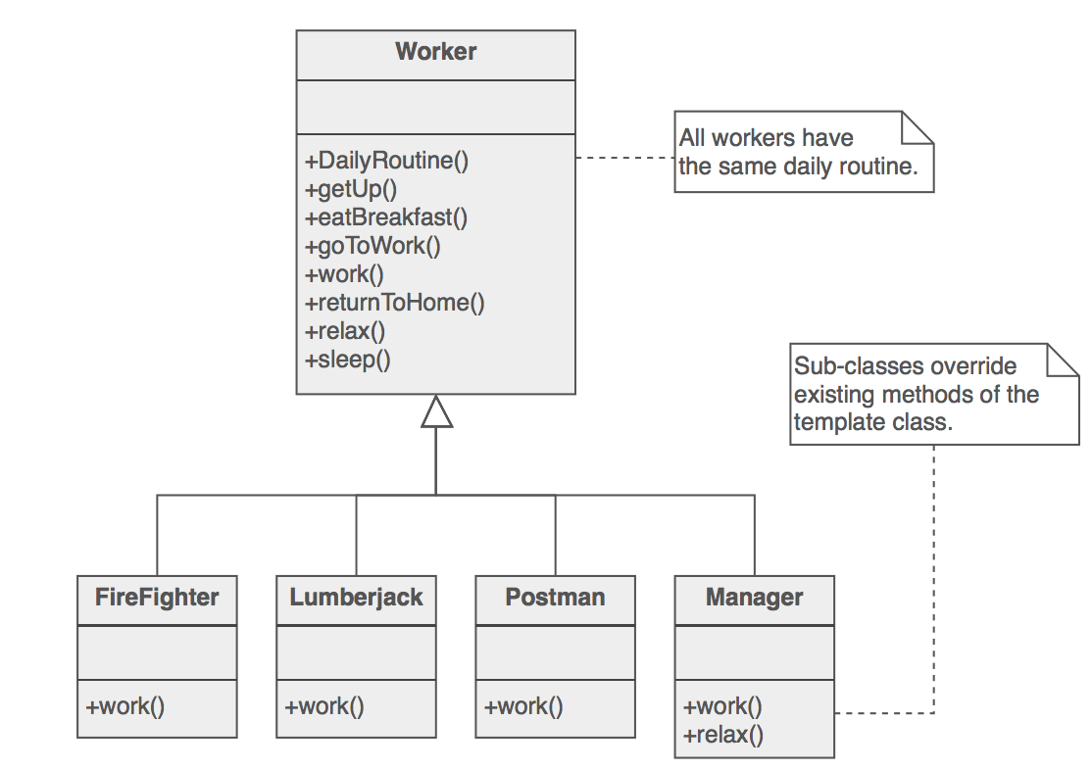
Example daily routine of a worker.

Slide 20
Applying Template Method
template method
SQL Cmd
connectDB();
makeQuery();
executeQuery();
disconnectDB();
processResult();
return result;
Steps that are common.
execute(): Object
makeQuery()
processResult()
connectDB()
executeQuery()
disconnectDB()
hook methods
Steps that are different.
reused by the subclasses
GetUser
GetBook
SaveLoan
SaveBook
GetUser(uid: String)
makeQuery()
processResult()
GetBook(cn: String)
makeQuery()
processResult()
SaveLoan (Loan l) makeQuery()
processResult()
SaveBook (b:Book) makeQuery()
processResult()
query=“select * from UserTable where UserTable.uid=\””+uid+”\””;
query= “insert into LoanTable (...)”;

Slide 21
Template Method Pattern
Skeleton code in which the abstract hook methods are invoked.
AbstractClass
templateMethod()
hookMethod1()
hookMethod2()
Concrete1
Concrete2
hookMethod1()
hookMethod2()
hookMethod1()
hookMethod2()
Concrete subclasses implement the hook methods to provide varying behaviors.

Slide 22
Benefits of Template Method
It defines the code skeleton with hook methods to provide varying behaviors implemented by subclasses.
It can be used to extract common code from the subclasses into a template method of the parent class to facilitate maintenance.
It reduces the effort required to implement the subclasses.
Variation: The parent class may provide default implementations for the hook methods.

Slide 23
Rules of thumb
Strategy is like Template Method except in its granularity.
Template Method uses inheritance to vary part of an algorithm. Strategy uses delegation to vary the entire algorithm.
Strategy modifies the logic of individual objects. Template Method modifies the logic of an entire class.
Factory Method is a specialization of Template Method.

Slide 24
The Result Is the Factory Method Pattern
...
Product p=hookMethod2();
...
Factory
method
AbstractClass
templateMethod()
hookMethod1()
hookMethod2()
: Product
Product
Product 1
Product 2
Concrete1
Concrete2
hookMethod1()
hookMethod2()
hookMethod1()
hookMethod2()
: Product
: Product
Factory method is a special case of template method –template method applied to object creation.
return new Product1();
return new Product2();

Slide 25
DBMgr Design: Accessing a Remote Database
DBMgr
DB Access Impl
getUser(uid):User
getBook(callNo):Book
saveLoan(loan)
saveBook(book)
getUser(uid):User
getBook(callNo):Book
saveLoan(loan)
saveBook(book)
...
impl
One or more databases may be at a remote location. The concrete DB access implementations may need to implement network communication.
LDAP Access
Oracle Access
SQL Access
getUser(uid):User
getBook(callNo):Book
saveLoan(loan)
saveBook(book)
...
getUser(uid):User
getBook(callNo):Book
saveLoan(loan)
saveBook(book)
...
getUser(uid):User
getBook(callNo):Book
saveLoan(loan)
saveBook(book)
...

Slide 26
Applying Remote Proxy Pattern
DBMgr
DB Access Impl
imp
getUser(uid):User
getBook(callNo):Book
saveLoan(loan)
saveBook(book)
Net Interface
openSocket(...)
closeSocket(...)
...
getUser(uid):User
getBook(callNo):Book
saveLoan(loan)
saveBook(book)
SQL Access Proxy
network
Remote SQL Access
getUser(uid):User
getBook(callNo): Book
saveLoan(loan)
saveBook(book)
openSocket(...)
closeSocket(...)
...
getUser(uid):User
getBook(callNo):Book
saveLoan(loan)
saveBook(book)
openSocket(...)
closeSocket(...)
...
Use TCP/IP, Java RMI, or CORBA to call the remote object.
Remote SQL DB

Slide 27
Proxy Pattern
Problems:
Accessing a remote object is not desired or not possible.
Providing a placeholder for an expensive object.
Controlling access to an object to implement access rights.
Solution:
Add a level of indirection with a proxy that implements the same interface as the real object.
The proxy controls and enhances the access to the real object.
Interface
operation ()
Real Object
Proxy
operation ()
operation ()
subject
delegate to
Implements additional functionality in addition to calling subject.operation().

Slide 28
Types of Proxy
Remote proxy: providing a local presence for an object in a different address space:
Example: a remote database
Using Java RMI (Remote Method Invocation)
CORBA (Common Object Request Broker Architecture)
Virtual proxy: acting as a placeholder for an expensive object to be created later
Protection proxy: controlling access to another object according to access rights
Smart reference proxy: performing additional actions when the original object is accessed

Slide 29
How to Reduce Number of Classes
Car
Do different cars have
different behavior and
different relationships?
housepower
numOfSeats
milesPerGallon
If not, then only one
class is sufficient.
...
Toyota
Santana
Ford
Camry
Corolla
Edge
Granada

Slide 30
Prototype Pattern
get prototype
<<Singleton>>
ProtoMgr
get(key):Object
add(key, Object)
remove(key)
maintain
Client
operation()
prototype
*
Prototype
clone():Object
*
ProtoMgr pm =
ProtoMgr.getInstance();
Prototype p=pm.get(“Ford Edge”);
if (p==null) {
Car edge=new Car();
edge.setMake(“Ford”);
edge.setModel(“Edge”);
...
pm.add(“Ford Edge”, edge);
p=pm.get(“Ford Edge”);
}
Car c=(Car)p.clone();
c.setX(...); ...
Car
Document
make
model
housepower
numOfSeasts
milesPerGallon
type
callNumber
author
title
clone():Object
...
...
clone():Object
...

Slide 31
Prototype Pattern
Benefits
Reducing the number of classes
Easy to add/remove prototypes at run time
Improving complex object creation efficiency
Support dynamically loaded classes (DLC)
DLC cannot be referenced at compile time.
The class loader creates and registers an instance of the DLC at run time when the DLC is loaded
As an alternative to abstract factory – avoiding the factory hierarchy parallel to the product hierarchy

Slide 32
Prototype Pattern
Liabilities
Each subclass of Prototype must implement the clone operation
deep copy if copy and original must be independent
shallow copy is sufficient otherwise
Implementing clone may be difficult if
the component objects do not support cloning, or
there are circular references

Slide 33
Persistence Framework: Putting It Together
Controller
DBMgr
DB Access Interface
Net Interface
getX(): X
saveX(x:X)
getX(): X
saveX(x:X)
openSocket()
closeSocket()
calls hook1() and hook2()
DBX Cmd
DBX Access
DBY Proxy
Remote DBY
execute(): Object
hook1()
hook2(): Object
getX(): X
saveX(x:X)
getX(): X
saveX(x:X)
openSocket()
closeSocket()
getX(): X
saveX(x:X)
openSocket()
closeSocket()
bridge
Get X
Save X
remote proxy
GetX(...)
hook1()
hook2(): Object
SaveX(...)
hook1()
hook2(): Object
command, template method and factory method

Slide 34
Visitor Pattern
Problem: It should be possible to define a new operation for (some) classes of an object structure without changing the classes.
When new operations are needed frequently and the object structure consists of many unrelated classes, it's inflexible to add new subclasses each time a new operation is required.
Solution: Define a separate (visitor) object that implements an operation to be performed on elements of an object structure.
Clients traverse the object structure and call a dispatching operation accept(visitor) on an element — that "dispatches" (delegates) the request to the "accepted visitor object". The visitor object then performs the operation on the element ("visits the element").

Slide 35
Example: Checking Components of a Car
Engineer
Brake
Body
Engine
Transmission
Fuel
Injector
Fuel
Filter
Combustor
Electronic
Engineer
Mechanics
Computer
Engineer
When analyze a car, a specific engineer will visit each component of the car and check each component according to his specialty.

Slide 36
Applying Visitor Pattern
Car
Client code:
Engineer e=new ...;
Iterator it=comp.iterator();
while (it.hasNext()) {
CarComp c=(CarComp)it.next();
c.accept(e);
}
check me
* comp
Engineer
CarComp
check(e:Engine)
check(b:Brake)
get info
accept(e: Engineer)
Engine
Brake
ComputerEng.
Mechanics
accept(e: Engineer)
//other op
accept(e: Engineer)
//other op
check(e:Engine)
check(b:Brake)
check(e:Engine)
check(b:Brake)
e.check(self)
e.check(self)

Slide 37
Object Interaction in the Visitor Pattern
<<visitor>>
client:
:CarComp
e:Mechanics
i:Iterator
c:CarComp
create()
create()
i:=iterator()
i.hasNext()
c:=next()
accept(e)
check(self)
x:=getX()
analyze x
get information about the car component

Slide 38
Single-Dispatch and Double-Dispatch
Without using visitor:
Using visitor:
CarComp
CarComp
accept(Visitor)
checkPCB()
checkMech()
v.visit(self)
v.visit(self)
Engine
Brake
accept (v:visitor)
accept (v:visitor)
Engine
Brake
checkPCB()
checkMech()
checkPCB()
checkMech()
Visitor
check(e:Engine)
check(b:Brake)
CarComp c=new ...;
c.checkPCB();
c.checkMech();
CE Visitor
ME Visitor
check(e:Engine)
check(b:Brake)
check(e:Engine)
check(b:Brake)
request
receiver
request
Double dispatch
Single dispatch
CE: Computer Engineering
ME: Mechanical Engineering

Slide 39
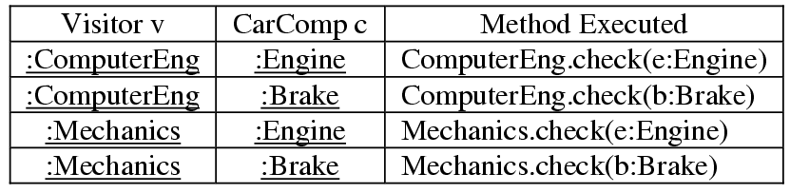
Understanding Visitor Pattern
Client
Visitor
components
visit
*
CarComp
check(e:Engine)
check(b:Brake)
Collection
accept(Visitor)
ComputerEng
Mechanics
Engine
Brake
check(e:Engine)
check(b:Brake)
check(e:Engine)
check(b:Brake)
accept (v:visitor)
accept (v:visitor)
// Client code:
Visitor v=new ...;
Iterator it=components.iterator();
while (it.hasNext()) {
CarComp c=(CarComp)it.next();
c.accept(v);
}
v.visit(self)
v.visit(self)

Slide 40
How to Apply Visitor Pattern
Without using visitor
Each class is assigned too many responsibilities.
The functions are not related – low cohesion.
Difficult to introduce new functions.
C0
f1()
f 2()
C1
C2
C3
f1()
f2()
f1()
f2()
f1()
f2()
Using visitor
applies f1() to C1, C2, C3
Visitor
v.visit(self)
visit(C1)
visit(C2)
visit(C3)
visit
1+
C0
accept(v:visitor)
C1
C2
C3
Visitor 1
Visitor 2
visit(C1)
visit(C2)
visit(C3)
visit(C1)
visit(C2)
visit(C3)
applies f2() to C1, C2, C3

Slide 41
The Visitor Pattern
Benefits
higher cohesion
without using Visitor, unrelated responsibilities are assigned to each class of the class structure
on the contrary, the visit(c: Ci) methods of each concrete visitor implement one functionality
support expert pattern
each concrete visitor class may store information that is needed to fulfill the functionality
the concrete visitor classes collaborate with objects of the structure to fulfill the responsibility
Support separation of concerns
the Visitor pattern separates the concerns into the concrete visitors, which can be used by different applications
Easy to add analysis functions
simply add concrete visitor classes
Visitors can accumulate state as they visit each object of the class structure
A visitor can be a singleton if it does not contain instance or share variables.

Slide 42
The Visitor Pattern
Liabilities
Adding a new class Cj to the class structure is difficult
Need to add and implement visit(c:Cj) in each visitor class
May be cured by providing a default implementation in the abstract visitor root class
Breaking encapsulation of the class structure
A concrete visitor may need to access to the internal states of the objects visited.

Slide 43
Memento Pattern
Store and Restore State of an Object
In Java, one can use cloning to store and restore an object.
In C++, one can use the copy constructor.
Sometimes, it is desired that only the object itself is allowed to access the stored state.
The memento pattern solves this problem.

Slide 44
Memento Pattern

Slide 45
Memento Pattern
The Caretaker class refers to the Originator class for saving (createMemento()) and restoring (restore(memento)) originator's internal state. The Originator class implements (1) createMemento() by creating and returning a Memento object that stores originator's current internal state and (2) restore(memento) by restoring state from the passed in Memento object. (1) Saving originator's internal state: The Caretaker object calls createMemento() on the Originator object, which creates a Memento object, saves its current internal state (setState()), and returns the Memento to the Caretaker. (2) Restoring originator's internal state: The Caretaker calls restore(memento) on the Originator object and specifies the Memento object that stores the state that should be restored. The Originator gets the state (getState()) from the Memento to set its own state.

Slide 46
Interpreter Pattern
Problem: A grammar for a simple language should be defined so that sentences in the language can be interpreted. When a problem occurs very often, it could be considered to represent it as a sentence in a simple language (Domain Specific Languages) so that an interpreter can solve the problem by interpreting the sentence.
For example, when many different or complex search expressions must be specified. Implementing (hard-wiring) them directly into a class is inflexible because it commits the class to particular expressions and makes it impossible to specify new expressions or change existing ones independently from (without having to change) the class.
Solution: 1- Define a grammar for a simple language by defining an Expression class hierarchy and implementing an interpret() operation. 2- Represent a sentence in the language by an abstract syntax tree (AST) made up of Expression instances. 3- Interpret a sentence by calling interpret() on the AST.
The expression objects are composed recursively into a composite/tree structure that is called abstract syntax tree (see Composite pattern). The Interpreter pattern doesn't describe how to build an abstract syntax tree. This can be done either manually by a client or automatically by a parser.

Slide 47
Interpreter Pattern Uses
Specialized database query languages such as SQL.
Specialized computer languages that are often used to describe communication protocols.
Most general-purpose computer languages actually incorporate several specialized languages.
Interpreter pattern provides a way to evaluate language grammar or expression. This pattern involves implementing an expression interface which tells to interpret a particular context.

Slide 48
Interpreter Design components
AbstractExpression (Expression): Declares an interpret() operation that all nodes (terminal and nonterminal) in the AST overrides.
TerminalExpression (NumberExpression): Implements the interpret() operation for terminal expressions.
NonterminalExpression (AdditionExpression, SubtractionExpression, and MultiplicationExpression): Implements the interpret() operation for all nonterminal expressions.
Context (String): Contains information that is global to the interpreter. It is this String expression with the Postfix notation that has to be interpreted and parsed.
Client (ExpressionParser): Builds (or is provided) the AST assembled from TerminalExpression and NonTerminalExpression. The Client invokes the interpret() operation.
Notes:
AST = Abstract Syntax Tree

Slide 49
The Interpreter Pattern
Benefits
Easy to extend and change the grammar
Implementation is easy
Easy to add new interpretations, just add another operation to the interface and implement it in all the subclasses
Liabilities
Difficult to do for complex grammar (use a parser generator instead)

Slide 50
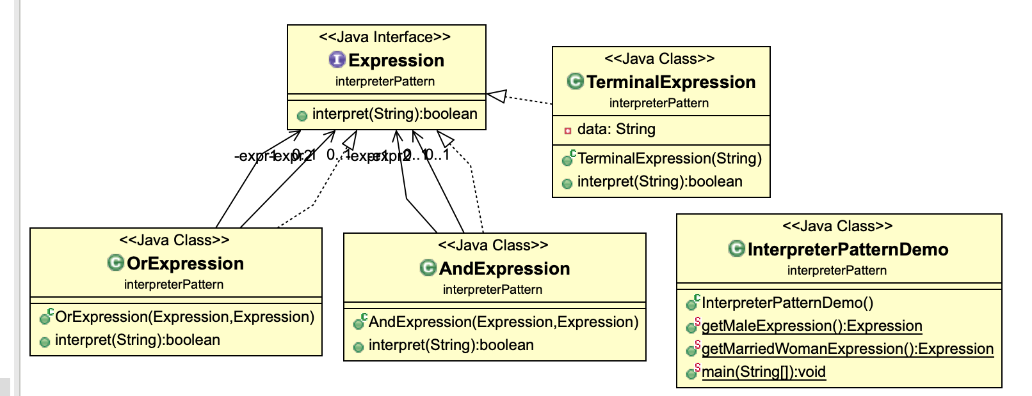
The Interpreter Pattern

Slide 51
Abstract Factory Pattern
The conditional statement suggests use of inheritance – subclasses replace conditional branches.
How to accomplish this?
since the versions differ in notations, one may treat the versions as subclasses one may let each version subclass create the modeling constructs for the given version
the result is an application of the Abstract Factory pattern

Slide 52
Abstract Factory Pattern(factory of factories)
Problem: How can an application be independent of how its objects are created? How can a class be independent of how the objects it requires are created? How can families of related or dependent objects be created?
Creating objects directly within the class that requires the objects is inflexible because it commits the class to particular objects and makes it impossible to change the instantiation later independently from (without having to change) the class. It stops the class from being reusable if other objects are required, and it makes the class hard to test because real objects can't be replaced with mock objects.
Solution: Encapsulate object creation in a separate (factory) object. That is, define an interface (AbstractFactory) for creating objects, and implement the interface. A class delegates object creation to a factory object instead of creating objects directly.
This makes a class independent of how its objects are created (which concrete classes are instantiated). A class can be configured with a factory object, which it uses to create objects, and even more, the factory object can be exchanged at run-time.
The essence of the Abstract Factory Pattern is to "Provide an interface for creating families of related or dependent objects without specifying their concrete classes."

Slide 53
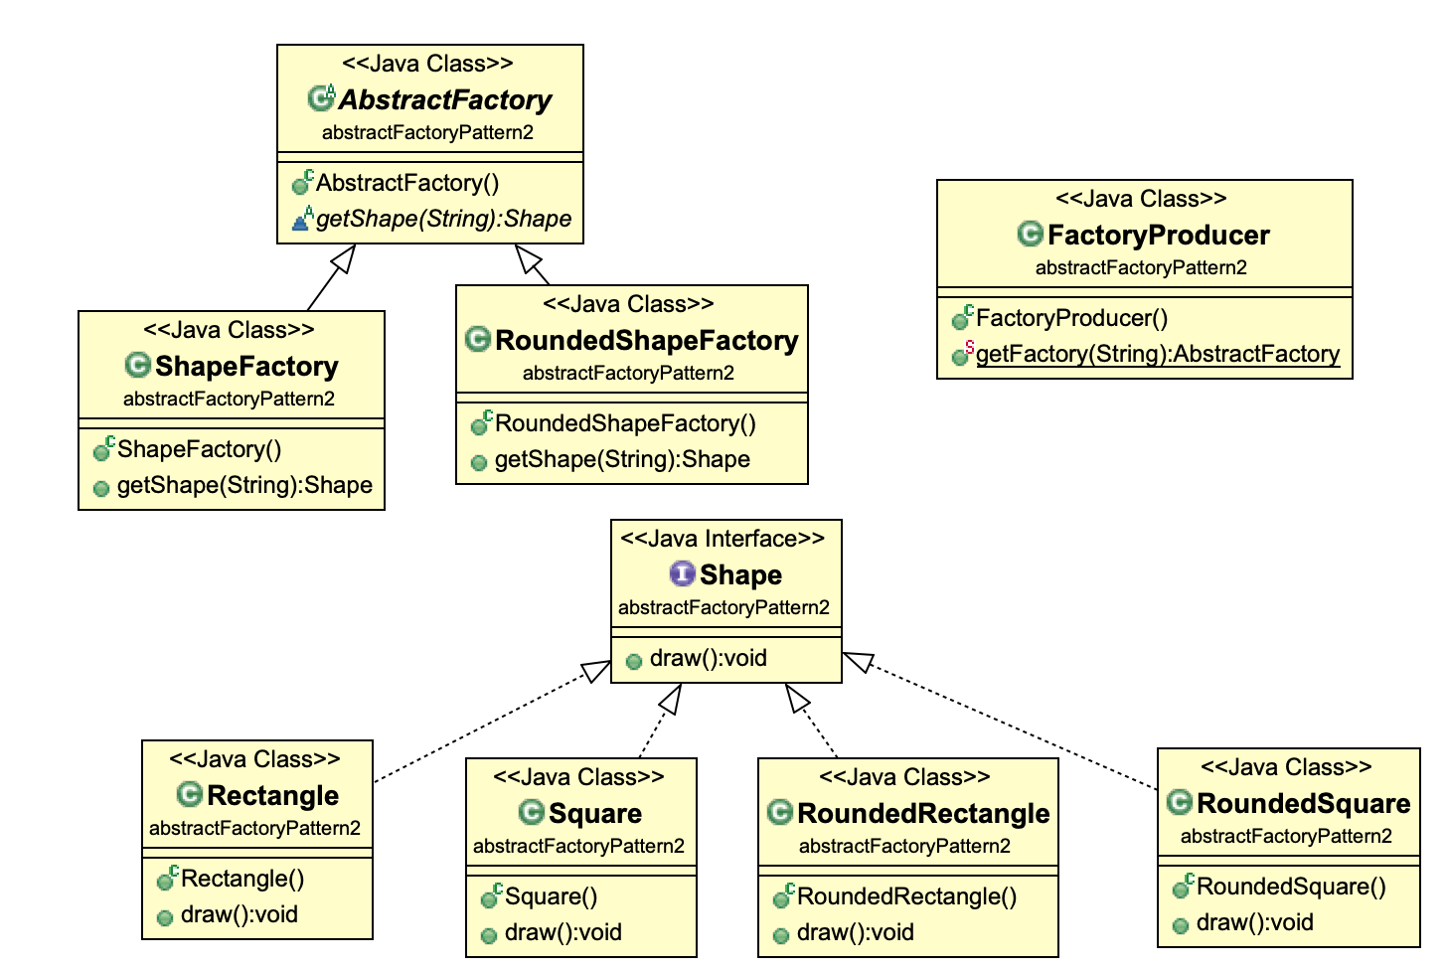
Abstract Factory Pattern

Slide 54
Abstract Factory Pattern
Benefits:
It provides an uniform interface for the client to creating products of different families.
A concrete factory is responsible for creating products of a given family.
Changing the concrete factory changes the family of products created.
It is easy to enforce the consistency of the products created.
It is easy to add new families of products, provided that they share the same interface.
Liabilities
It is not easy to add a new family of products that require a different product creation interface.
The concrete factories are responsible for enforcing the consistency among the products created.

Slide 55
Abstract Factory and Related Patterns
Factory method, prototype, and builder can be used to implement abstract factory.
Reusing prototypes to improve object creation efficiency.
Abstract Factory
These are factory methods.
Prototype Mgr
createX(): X
createY(): Y
get(key): Object
Concrete factories can be singletons.
Concrete Factory 1
Concrete Factory 2
createX(): X
createY(): Y
createX(): X
createY(): Y
Builder can implement create methods.

Slide 56
Builder Pattern
Problem: How can a class (the same construction process) create different representations of a complex object? How can a class that includes creating a complex object be simplified?
Creating and assembling the parts of a complex object directly within a class is inflexible. It commits the class to creating a particular representation of the complex object and makes it impossible to change the representation later independently from (without having to change) the class.
Solution: Encapsulate creating and assembling the parts of a complex object in a separate Builder object. A class delegates object creation to a Builder object instead of creating the objects directly.
A class (the same construction process) can delegate to different Builder objects to create different representations of a complex object.
The intent of the Builder design pattern is to separate the construction of a complex object from its representation. By doing so the same construction process can create different representations.

Slide 57
Builder Pattern
Advantages:
Allows you to vary a product’s internal representation.
It separates the product representation and construction concerns. Encapsulates code for construction and representation.
Provides control over steps of construction process.
Disadvantages
Requires creating a separate Concrete Builder for each different type of product.
Requires the builder classes to be mutable.
Data members of class aren't guaranteed to be initialized.
Dependency injection may be less supported.

Slide 58
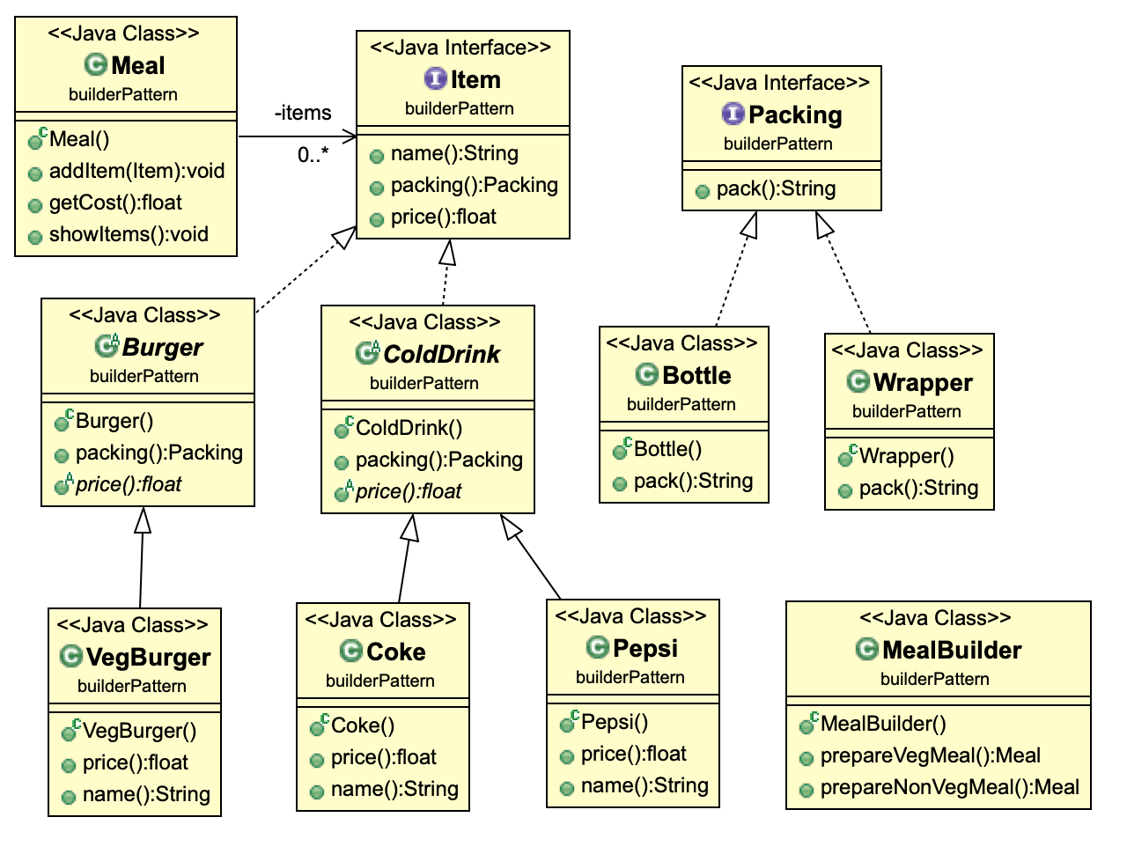
Builder Pattern

Slide 59
Builder vs Abstract Factory
Builder focuses on constructing a complex object step by step. Abstract Factory emphasizes a family of product objects (either simple or complex). Builder returns the product as a final step, but as far as the Abstract Factory is concerned, the product gets returned immediately.
Builder often builds a Composite.
Often, designs start out using Factory Method (less complicated, more customizable, subclasses proliferate) and evolve toward Abstract Factory, Prototype, or Builder (more flexible, more complex) as the designer discovers where more flexibility is needed.
Sometimes creational patterns are complementary: Builder can use one of the other patterns to implement which components get built. Abstract Factory, Builder, and Prototype can use Singleton in their implementations.
Abstract factory is concerned with the creation of similar products of different brands.
Builder can use abstract factory to vary the parts used by the build steps. Abstract factory can use builder to build products that need to vary the processes and steps.

Slide 60
Decorator Pattern
Problem: Responsibilities should be added to (and removed from) an object dynamically at run-time. A flexible alternative to subclassing for extending functionality should be provided.
When using subclassing, different subclasses extend a class in different ways. But an extension is bound to the class at compile-time and can't be changed at run-time.
Solution: Define Decorator objects that implement the interface of the extended (decorated) object (Component) transparently by forwarding all requests to it and perform additional functionality before/after forwarding a request.
This allows working with different Decorator objects to extend the functionality of an object dynamically at run-time.
This pattern is designed so that multiple decorators can be stacked on top of each other, each time adding a new functionality to the overridden method(s).

Slide 61
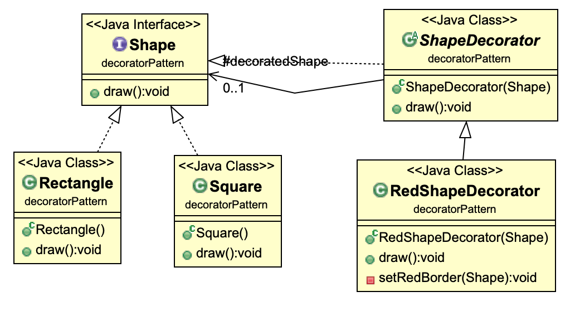
Decorator Pattern

Slide 62
Chain of Responsibility Pattern
Problem: It should be possible that more than one receiver can handle a request. How do we process requests when the exact handlers are not know in advance?
Example applications:
purchase order approval hierarchy
exception handling
business rules processing
providing context dependent help
Implementing a request directly within the class that sends the request is inflexible because it couples the class to a particular receiver and makes it impossible to support multiple receivers.

Slide 63
Chain of Responsibility Pattern
Solution: Define a chain of receiver objects having the responsibility, depending on run-time conditions, to either handle a request or forward it to the next receiver on the chain (if any).
This enables to send a request to a chain of receivers without having to know which one handles the request. The request gets passed along the chain until a receiver handles the request. The sender of a request is no longer coupled to a particular receiver.

Slide 64
Context Dependent Help
Using if-then-else or case statement
if (context==X)
showHelp1()
else if (context==Y)
showHelp2()
else if ...
This solution has high cyclomatic complexity.
It is difficult to change.
New context dependent help cannot be added dynamically.

Slide 65
Chain of Responsibility Pattern
successor
if (successor!=null)
successor.
handleRequest();
else {
// do default handling
}
Handler
has successor
create(next: Handler)
canHandle(): boolean
handleRequest()
Handler 1
Handler K
canHandle(): boolean
handleRequest()
canHandle(): boolean
handleRequest()
if (canHandle())
/* handle request */
else
super.handleRequest();
Handlers are chained from smaller scope to larger scope.
If a handler cannot handle the request, it passes the request to its successor.

Slide 66
Sample Code
public abstract class Handler {
Handler next;
public Handler (Handler next) {
this.next=next;
}
public abstract boolean canHandle();
public void handleRequest() {
if (successor!=null)
successor.handleRequest();
else {
/* do default handling */
}
}
public class HandlerJ extends Handler {
public HandlerJ (Handler next)
{ super(next); }
public boolean canHandle()
{ /* implement this function */ }
public void handleRequest() {
if (canHandle())
/* handle request */
else {
super.handleRequest();
}
}

Slide 67
Chain of Responsibility Pattern
Benefits
Designing “stupid objects”
Each concrete handler does only one thing.
Each concrete handler knows only one successor.
The handlers do not know what the other handlers do.
Supporting separation of concerns
The responsibilities to handle the requests are assigned to different concrete handlers.
The chain of handlers can be updated dynamically.
Liabilities
A request may not be handled.

Slide 68
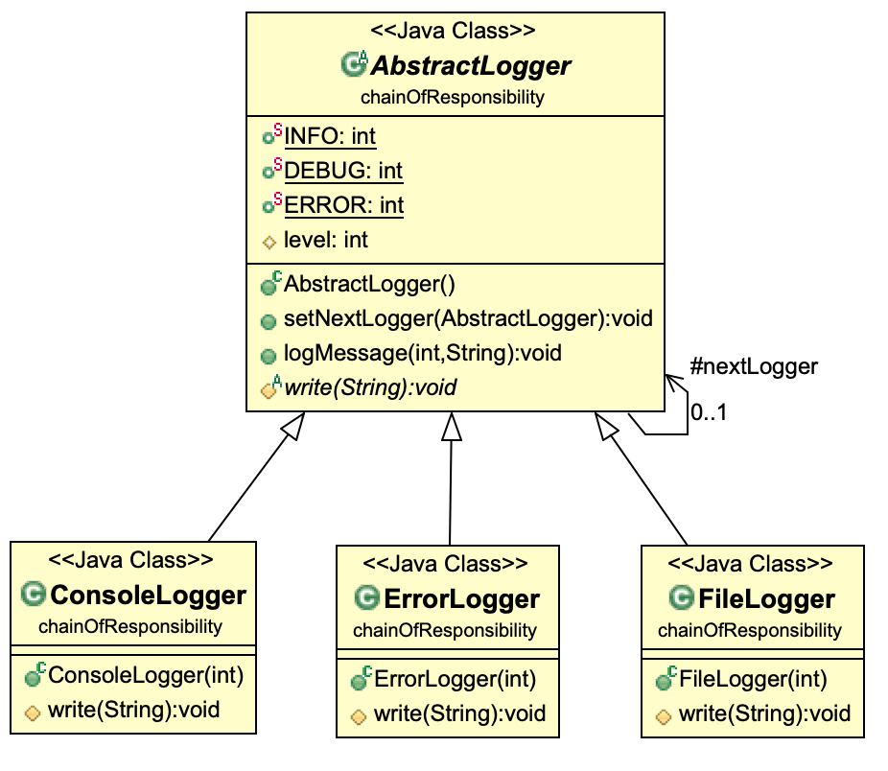
Chain of Responsibility Pattern

Slide 69
Handling Numerous Occurrences of an Object
An object may have numerous occurrences.
Representing each occurrence as an object is very costly.
problem: How does one represent such occurrences in a computer?
How do we represent and manipulate the small squares efficiently?
Logical representation – extrinsic state, non-sharable properties: position, typographic style, etc.
Physical representation – sharable, intrinsic state: font, color, character code, image, etc.

Slide 70
Flyweight Pattern
Client
FlyweightFactory
*
Flyweight
flyweights
getFlyweight(key:String)
operation()
if (flyweights.get(key)==null) {
Class c=Class.forName(key);
flyweights.add(c.newInstance());
}
return flyweights.get(key);
Flyweight 1
Flyweight 2
Flyweight 3
operation()
operation()
operation()

Slide 71
Interaction in the Flyweight Pattern
:Flyweight
Factory
Flyweight
:Client
g:Graphics
f:=flyweights.
get(key)
f:=getFlyweight
(key)
[f==null]
create (intrinsicState)
flyweights.
add (key, f)
draw(g,x,y)
draw(c,x,y)

Slide 72
Applying Flyweight
if (flyweights.get(c, f, size)==null) {
Char ch=new Char (c, f, size);
flyweights.add(ch); }
return flyweights.get(c, f, size);
CharFlyweightFactory
Char
*
get (c:char, f:Font, size:int)
flyweights
create(c:char, f:Font, size:int)
draw(...)
R e p r e s e n t i n g ...
:Char
:Char
...
:Char
:Char
:Char
...
Flyweights
‘R’:char
...
‘e’:char
...
‘p’:char
...
‘r’:char
...
‘s’:char
...

Slide 73
Flyweight Pattern
It is the opposite of singleton
flyweight: need to create numerous instances of a class.
singleton: need to create at most one instance of a class.
Benefits of flyweight:
reduces memory requirements
improves object creation efficiency
Liabilities:
May incur run time overhead to search, transfer and compute extrinsic state.

Slide 74
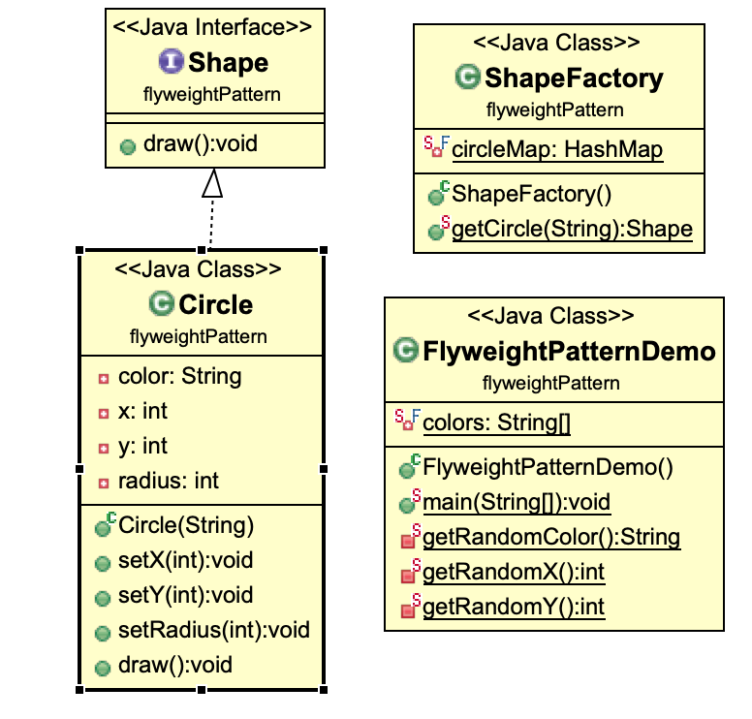
Flyweight Pattern
Flyweight pattern tries to reuse already existing similar kind objects by storing them and creates new object when no matching object is found. We will demonstrate this pattern by drawing 20 circles of different locations but we will create only 5 objects. Only 5 colors are available so color property is used to check already existing Circle objects.

